Slide 1
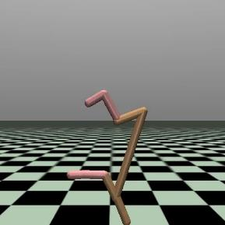
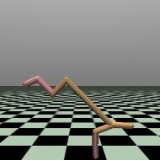
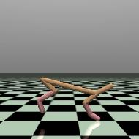
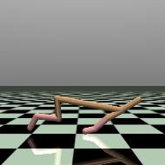
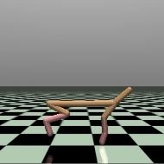
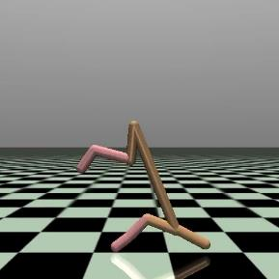
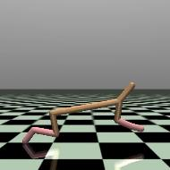
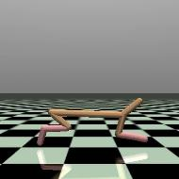
Project
Group
8
Exploring
Reinforcement
Learning
Techniques
in HalfCheetah-v2
MuJoCo environment

Slide 2
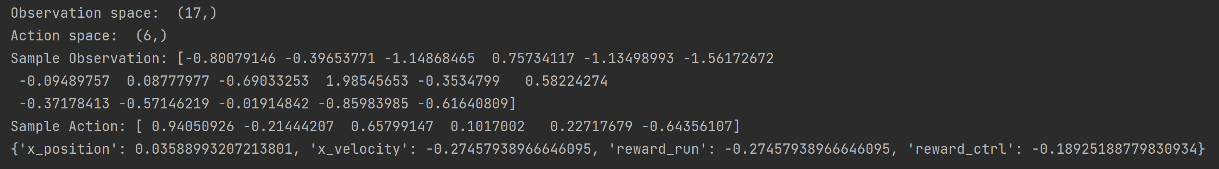
ENVIRONMENT DESCRIPTION
The HalfCheetah-v2 environment is part of Mujoco (Multi-Joint Dynamics with Contact), which is an advanced physics simulation engine present in the OpenAI Gym library.
Observation space consists of 17 observations:
5 Body observations
12 Angular observations
Action space consists of 6 actions:
6 Hinge Actuators
Each observation ranges from [-inf, inf]
Each action ranges from [-1, 1]
It has 2 types of reward signal: –
reward_forward / reward_run: The reward for moving, ignoring the control cost
reward_ctrl: The reward for acting i.e., the control cost (always negative)
Continuous observation-control task

Slide 3
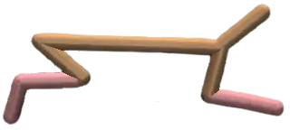
ENVIRONMENT DESCRIPTION
12 Hinge Observations:
Angle (rad)
Angular velocity (rad/s)
3 Hinge actuators (back):
torque (Nm)
3 Hinge actuators (back):
torque (Nm)
5 Body Observations:
X-axis:
Distance (m)
Velocity (m/s)
Y-axis:
Rotation (rad)
Z-axis:
Distance (m)
Velocity (m/s)

Slide 4
MODEL FREE METHODS
Leveraged 2 TD-learning methods
Off-Policy – Q-learning Update rule:
Q(s, a) = Q(s, a) + α * (r + µ * max_{a'}(Q(s', a')) - Q(s, a))
On-Policy – SARSA Update rule:
Q(s, a) = Q(s, a) + α * (r + µ * Q(s', a') - Q(s, a))
Parameters used:
α (learning rate) = 0.8
µ (discount factor) = 0.99
Continuous state and action spaces discretized into 'k' bins where k = 2.
Binned state space vector – (2, 2, 2, 2, 2, 2, 2, 2, 2, 2, 2, 2, 2, 2, 2, 2, 2)
Binned action space vector– (2, 2, 2, 2, 2, 2).
Clipped the minimum and maximum ranges for observations from [-inf, inf] to [-25, 25] by observing ~10k random samples from the environment.
Size of state and action space increases exponentially with number of bins with:
total Q table size = na_bins^{n_actions} * ns_bins^{n_observations} = 2⁶ * 2¹⁷
Total reward the agent receives = reward_run + reward_ctrl
Policy selected using Epsilon Greedy with:
base epsilon value of 0.99
decaying at a rate of log₁₀((e^{epsilon} + 1) / 25)

Slide 5
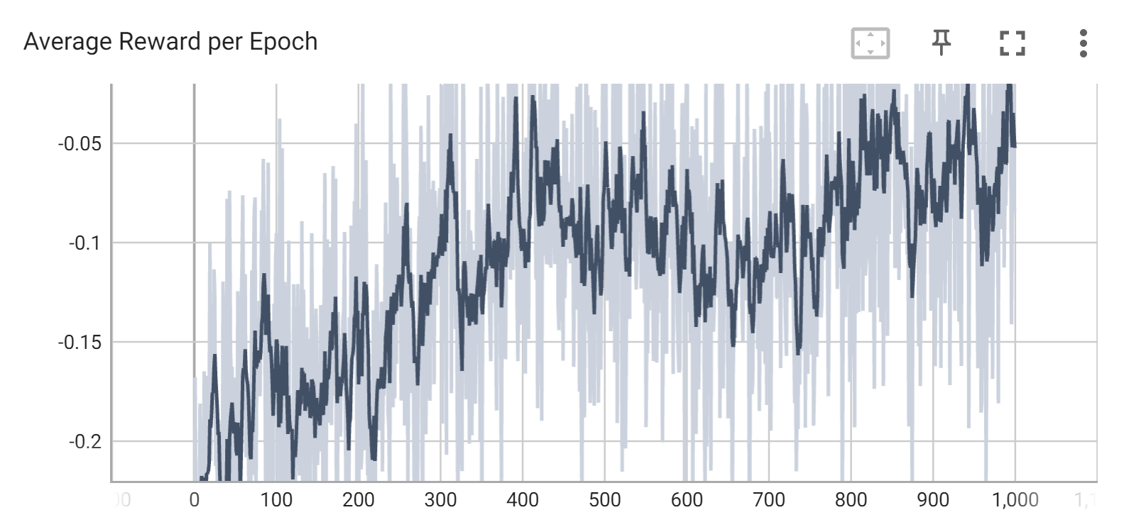
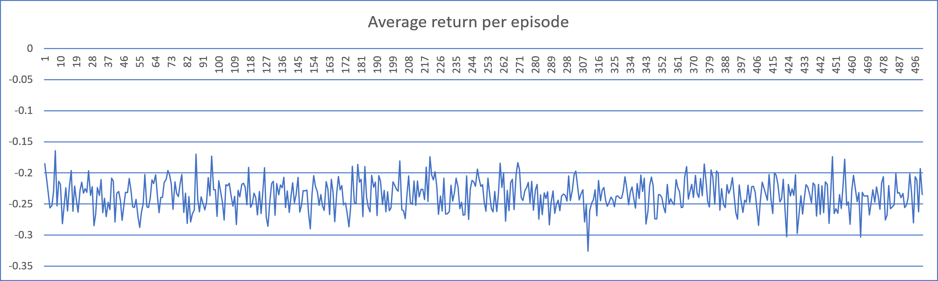
Q-LEARNING vs. SARSA PREMILINARY RESULTS

Slide 6
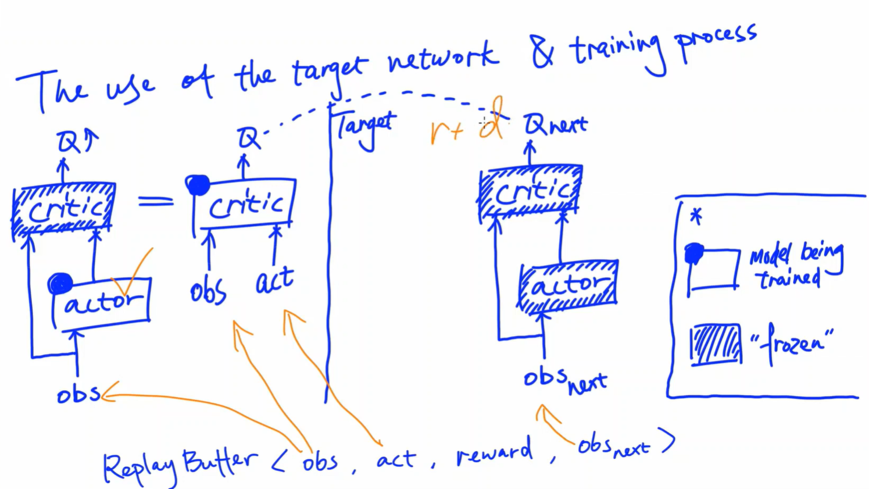
STATE SPACE TOO LARGE? - POLICY GRADIENT DDPG
Value based learning inefficient due to curse of dimensionality. Therefore, we leverage policy gradient methods for directly learning a parameterized policy.
However, for continuous control tasks naïve policy gradient works poorly. Therefore, we combine value and policy learning.
Deep Deterministic Policy Gradient (DDPG) is a model-free off-policy algorithm for learning continuous actions. It uses the structure of actor-critic model, where the policy plays the role of an actor and the value acts as a critic for the policy and a replay buffer – we learn from previous experiences (states, actions, rewards, next states).
Simultaneous generation of values from the critic network results in instability in training hence, DDPG uses 2 target networks to stabilize the training of critic.
The actor learns by freezing the critic network and feeding in observations from the replay buffer. The critic learns from the difference between its frozen target network which generates Q_{next} and its other target network which generates Q of current state.
Objective of actor = maximize(Q) and Objective of critic = minimize(Q - (reward + discount * Q_{next}))

Slide 7
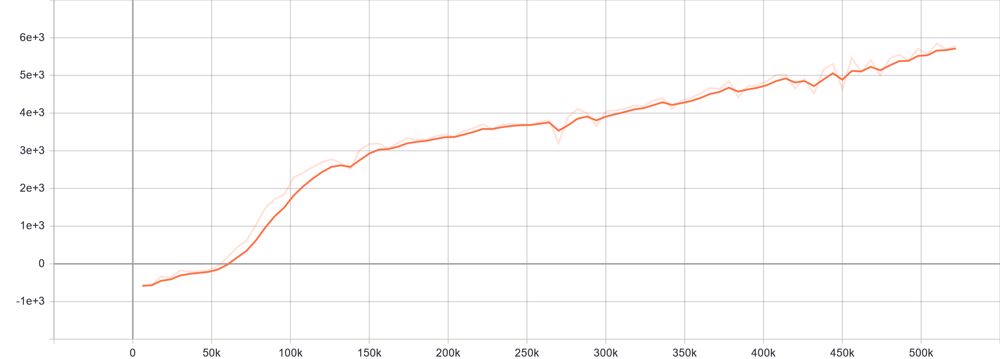
DDPG PREMILINARY RESULTS
Return
Epoch

Slide 8
PLANS FOR FINISHING UP
We plan to train more episodes on DDPG and explore other policy evaluation methods, if time permits
We also plan to generalize the approach to accommodate any continuous space and action reinforcement learning problem; so that it can be applied to other Mujoco use cases.
And, before finishing up…

